Slide 1
eHealth Architectures
A brief survey of HIE designs.

Slide 2
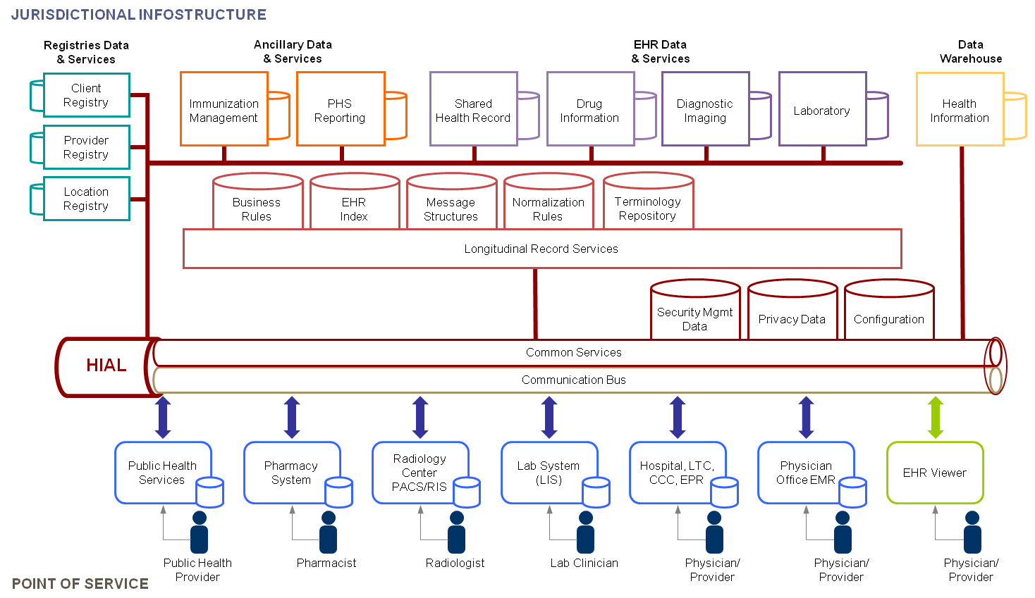
Canada (v2, 2006)

Slide 3
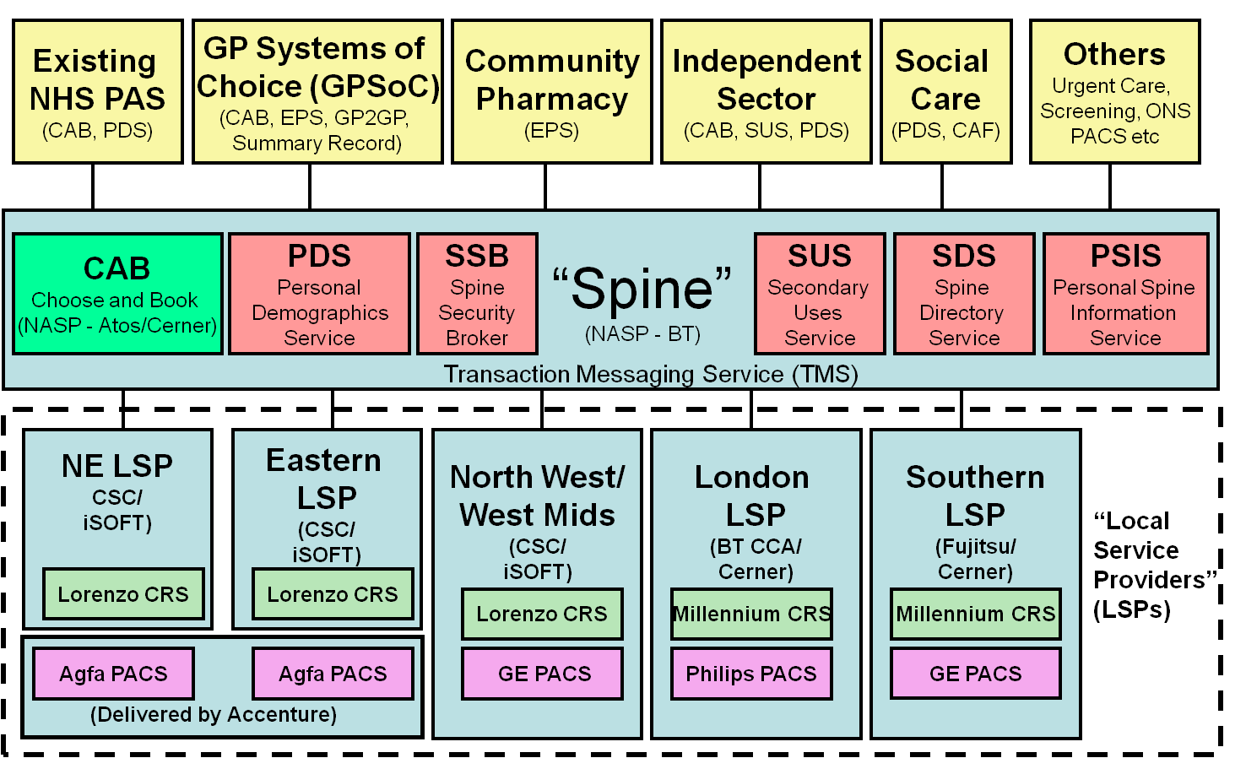
UK (v2 “actual”, 2007)

Slide 4
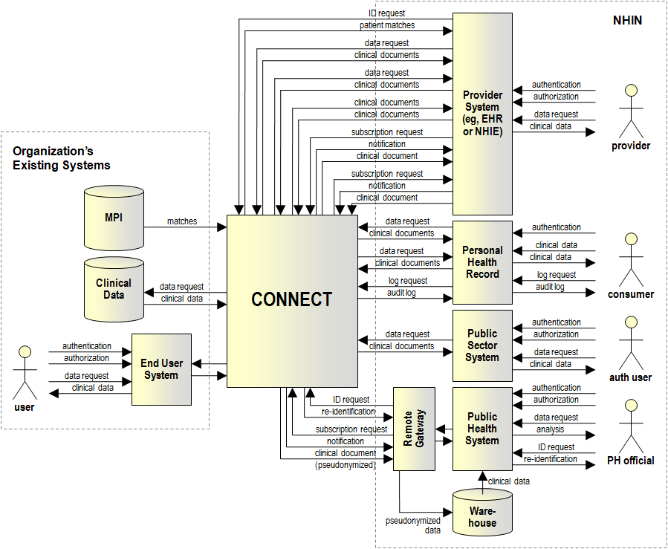
US NwHIN (2009)

Slide 5
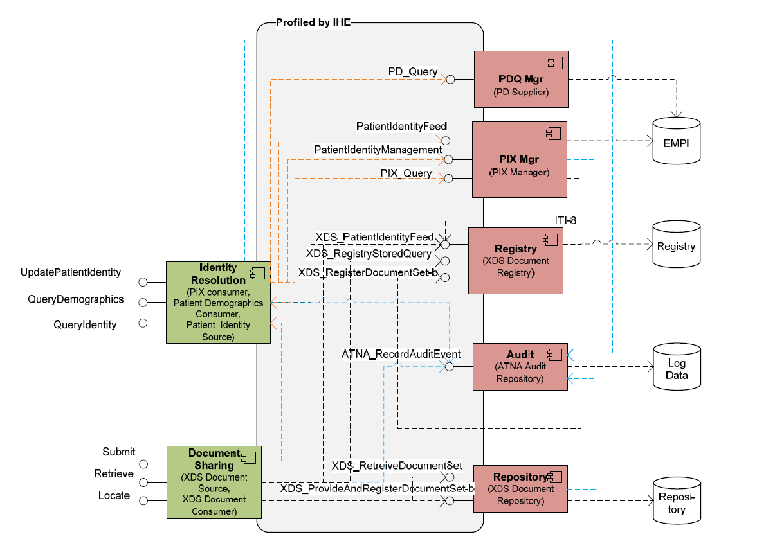
IHE “SOA Example” (2010)

Slide 6
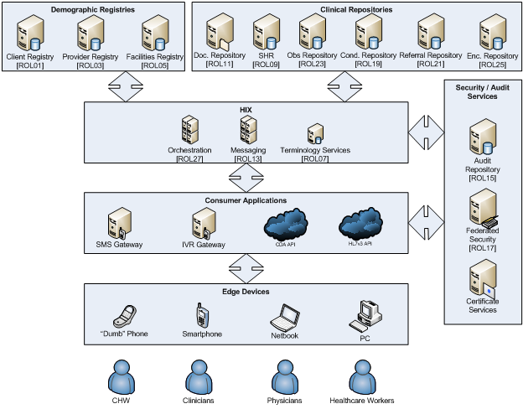
CHP “Conceptual” Design (2011)

Slide 7
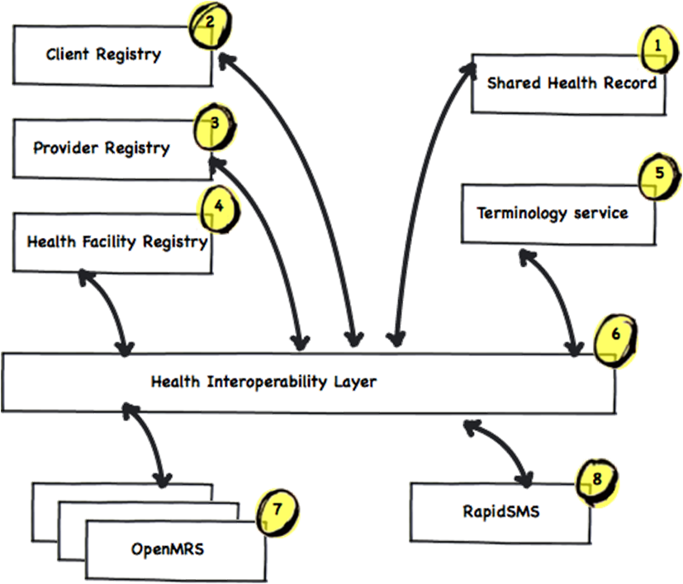
RHEA (2011)

Slide 8
Two distinct patterns…
Federated point-to-point Messaging
(US, IHE)
Service-oriented “Bus” Architecture
(CA, UK, RW, CHP)

